Slide 1
Compiler
Segment 2
Segment 3

Slide 2
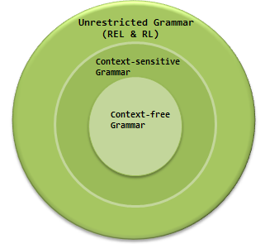
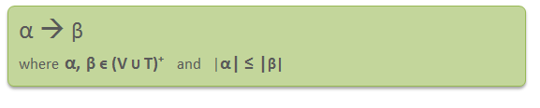
Context Sensitive Grammar
A Context-sensitive grammar is an Unrestricted grammar in which all the productions are of form –
Where α and β are strings of non-terminals and terminals.

Slide 3
CSG:Definition
Context-sensitive grammar has 4-tuples. G = {N, Σ, P, S}, Where
N = Set of non-terminal symbols
Σ = Set of terminal symbols
S = Start symbol of the production
P = Finite set of productions
All
Context-sensitive Language: The language that can be defined by context-sensitive grammar is called CSL. Properties of CSL are :
Union, intersection and concatenation of two context-sensitive languages is context-sensitive.
Complement of a context-sensitive language is context-sensitive.
rules in P are of the form α₁ A α₂ –> α₁ β α₂

Slide 4
CSG:Example
Consider the following CSG.
S → abc/aAbc
Ab → bA
Ac → Bbcc
bB → Bb
aB → aa/aaA
What is the language generated by this grammar?
Solution:
S → aAbc
→ abAc
→ abBbcc
→ aBbbcc
→ aaAbbcc
→ aabAbcc
→ aabbAcc
→ aabbBbccc
→ aabBbbccc
→ aaBbbbccc
→ aaabbbccc
The language generated by this grammar is {a^{n}b^{n}c^{n} | n≥1}.

Slide 5
Regular Grammar/Linear Grammar
In Computer Science, a linear grammar is a context free grammar that has at most one nonterminal in the right-hand side of each of its productions.
Regular grammar is a type of grammar that describes a regular language. A regular grammar is a mathematical object, G, which consists of four components, G = (V, T, P, S), where
V: non-empty, finite set of non-terminal symbols,
T: a finite set of terminal symbols, or alphabet, symbols,
P: a set of grammar rules, each of one having one of the forms
  A ⇢ aB
  A⇢ a
  A ⇢∈, Here ∈=empty string, A, B ∈ N, a ∈ ∑
S ∈ N is the start symbol.

Slide 6
Types of RG/LG
Example:
A ⇢ a,
A ⇢ aB,
A ⇢ ∈ where, A and B are non-terminals,
a is terminal, and ∈ is empty string
S ⇢ 00B | 11S
B ⇢ 0B | 1B | 0 | 1
where,
S and B are non-terminals,
and 0 and 1 are terminals
Right Linear Regular Grammar
Left Linear Regular Grammar
Right Linear Regular Grammar
In this type of regular grammar, all the non-terminals on the right-hand side exist at the rightmost place, i.e; right ends.

Slide 7
Types of LG
Left Linear Regular Grammar
In this type of regular grammar, all the non-terminals on the right-hand side exist at the leftmost place, i.e; left ends.
Examples :
A ⇢ a,
A ⇢ Ba,
A ⇢ ∈
where, A and B are non-terminals, a is terminal, and ∈ is empty string
S ⇢ B00 | S11
B ⇢ B0 | B1 | 0 | 1
where S and B are non-terminals, and
0 and 1 are terminals

Slide 8
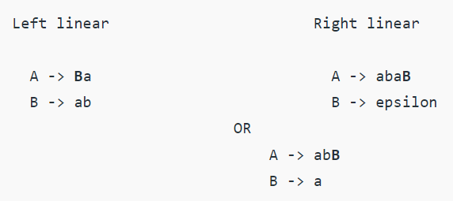
Left linear to Right Linear Regular Grammar
In this type of conversion, we have to shift all the left-handed non-terminals to right as shown in example given below:

Slide 9
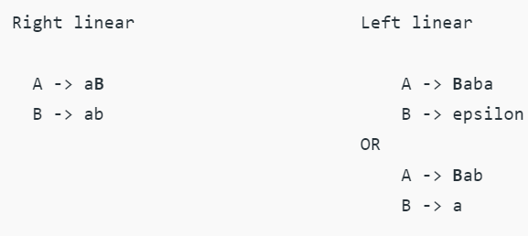
Right linear to Left Linear Regular Grammar
In this type of conversion, we have to shift all the right-handed non-terminals to left as shown in example given below:

Slide 10
Useless Nonterminal
Context-free grammars can contain errors, just as programs do. Some errors are easy to detect and fix; others are more subtle.
In context-free grammars we start with the start symbol, and apply productions until a terminal string is produced. Some context-free grammars may contain useless non-terminals.
Non-terminals that are unreachable (from the start symbol) or that derive no terminal string are considered useless
A grammar containing useless nonterminals is said to be non-reduced. After useless non-terminals are removed, the grammar is reduced.
Consider S → AB | x
B → b
A → aA
C → d

Slide 11
DFA TO REGULAR EXPRESSION
If there exists any incoming edge to the initial state, then create a new initial state having no incoming edge to it.
If there exists multiple final states in the DFA, then convert all the final states into non-final states and create a new single final state.
If there exists any outgoing edge from the final state, then create a new final state having no outgoing edge from it.

Slide 12
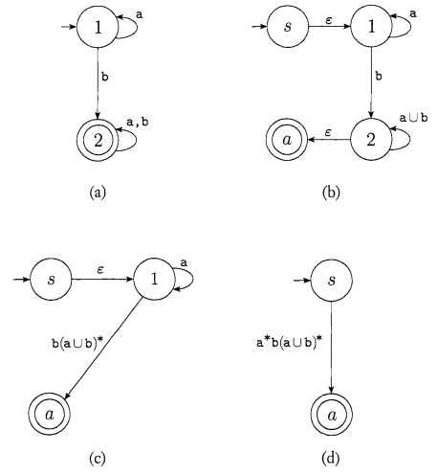
DFA to RE

Slide 13
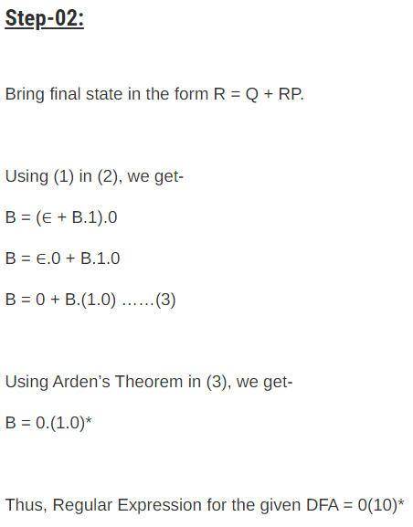
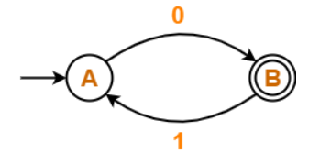
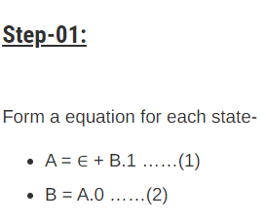
DFA to RE
Replace R by R=QP*

Slide 14
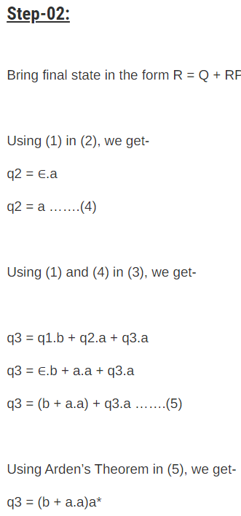
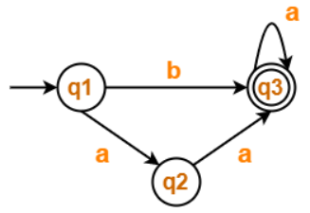
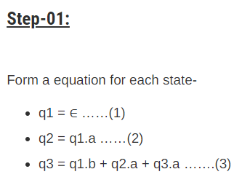
DFA to RE
Replace R by R=QP*

Slide 15
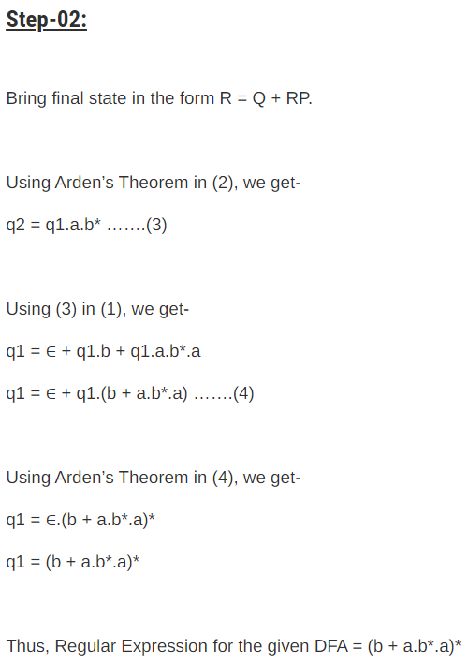
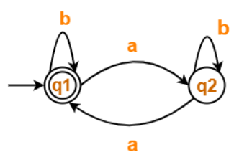
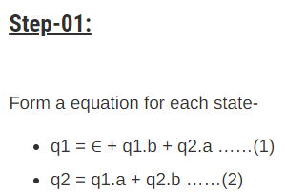
DFA to RE Example 3
Replace R by R=QP*

Slide 16
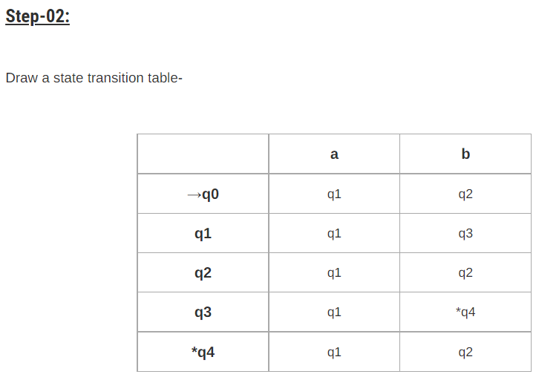
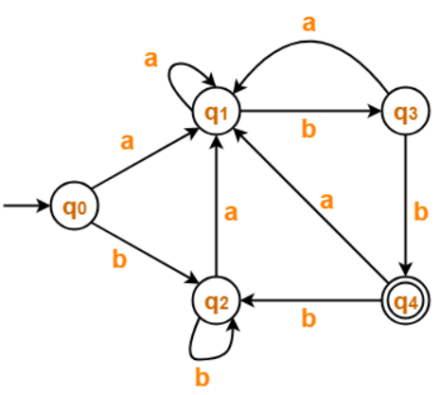
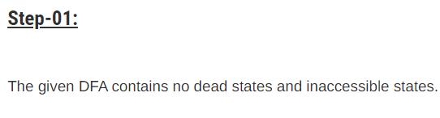
Minimization of DFA

Slide 17
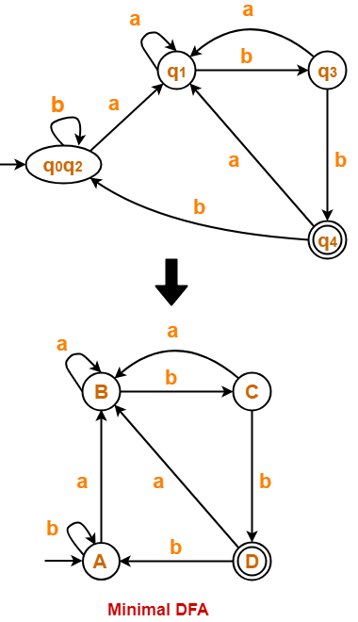
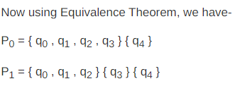

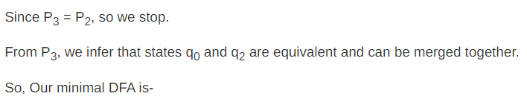
Minimization of DFA

Slide 18
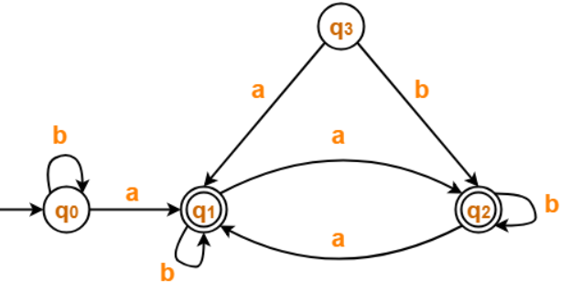
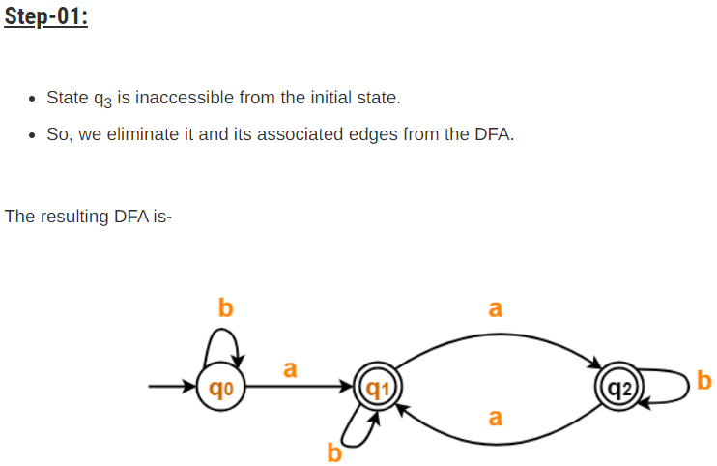
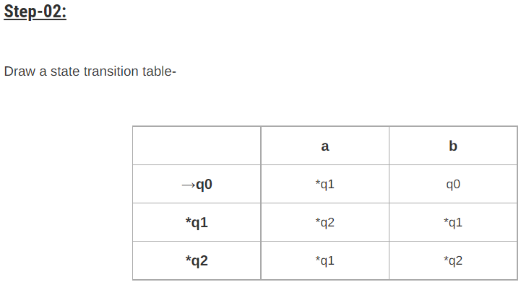
Minimization of DFA Example 2

Slide 19
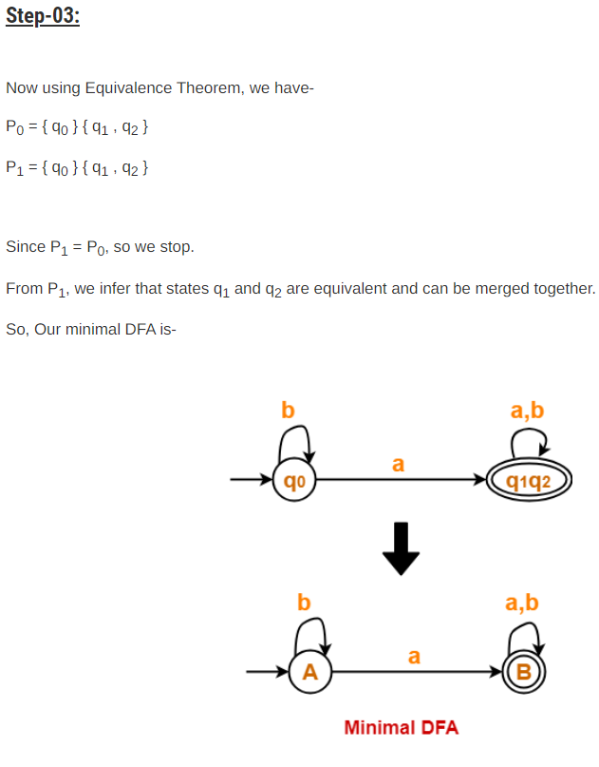

Slide 20
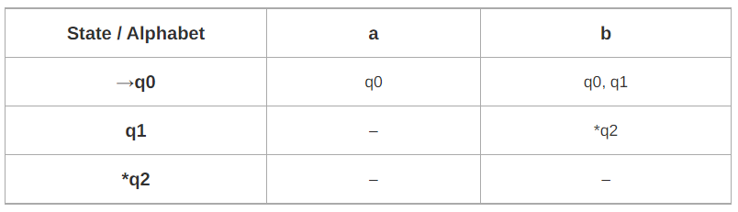
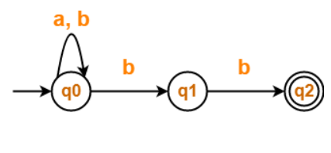
NFA TO DFA CONVERSION
State diagram NFA
Transition table NFA

Slide 21
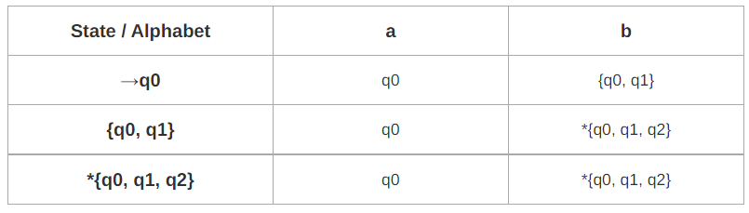
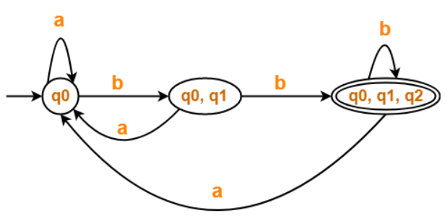
NFA to DFA
Transition Table DFA
State diagram DFA

Slide 22
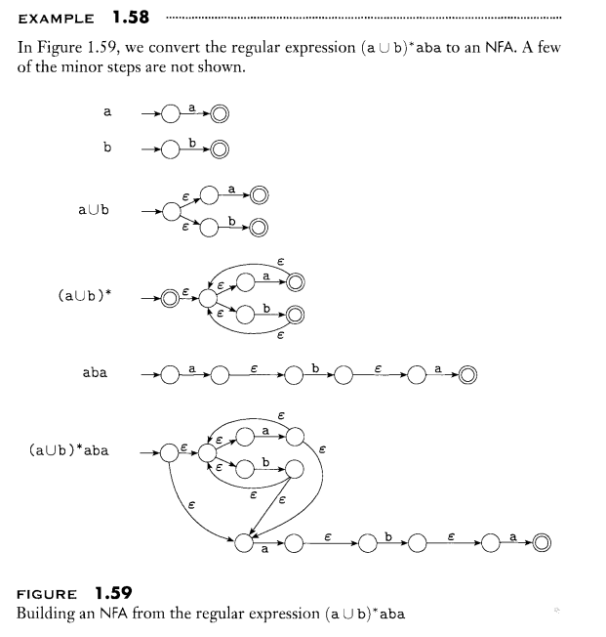
RE to NFA

